Slide 1



Meeting the Needs of English Language Learners through School Improvement
Jayne Sowers, Great Lakes East Comprehensive Center
Reyna Hernandez, Illinois Board of Education
Janet Filbin, Hope Online Learning Academy Co-Op

Slide 2
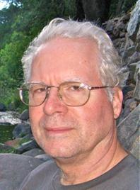
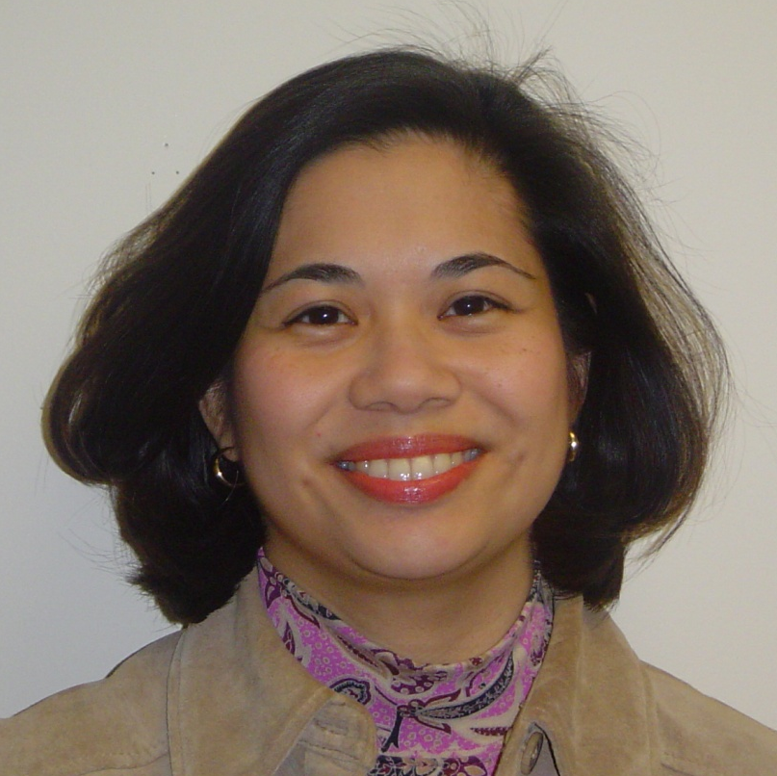
NNSSIL Co-coordinators
Tom Kerins
Associate Director for Program Development, Center on Innovation and Improvement
Nina de las Alas
Program Director, Council of Chief State School Officers
Notes:
2

Slide 3
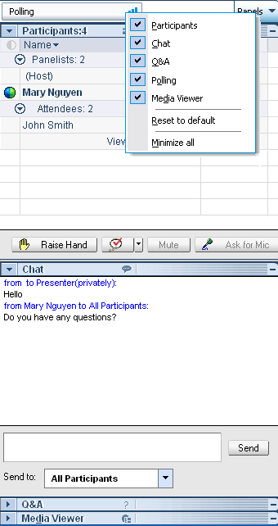
WebEx Panels & Features
Participants
Raise/lower hand
Chat
Q&A
Notes:
3

Slide 4
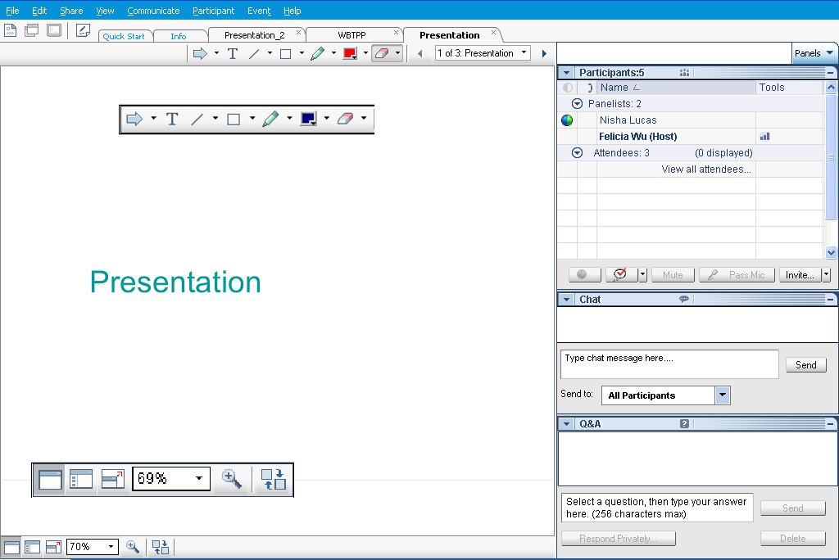
Webex Panels & Features
Presentations
Visual magnification
Audio volume (manual control through your phone or if using VOIP through computer’s audio controls . If you still cannot hear, please send Nina a chat message) or contact WebEx Tech Support (866-229-3239).
Notes:
4

Slide 5
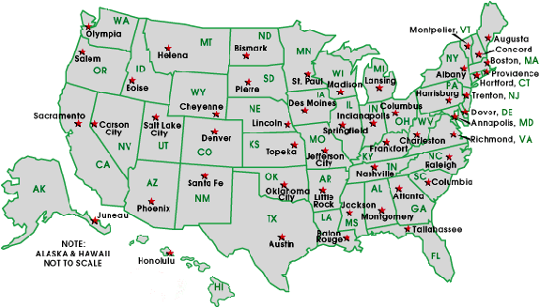
National Network of State School Improvement Leaders (NNSSIL)
Membership
50+ SEAs and territories
16 Regional Comprehensive
Centers (RCCs) & 5 Content
Centers
Advisory Group – Design Team
Subgroup of state reps., sub-dir.-level RCC
staffers, US ED, and NNSSIL co-coordinators
Administrative Partners
Center on Innovation & Improvement
Council of Chief State School Officers
More information: http://www.centerii.org/leaders
Notes:
Nina
This webinar is brought to you by NNSSIL. NNSSIL provides a forum for federal and state agency officials and national and regional technical assistance providers to engage in the area of school improvement and statewide systems of support and to share ideas, practices and knowledge among one other.
More information about NNSSIL is available in the website cited above.
And with that, let me pass things on to Susan.

Slide 6
Meeting the Needs of English Language Learners through School Improvement
Purpose
Introduce a reflective framework to assist SEA, LEA, and school staff to increase internal dialogue and integration of program supports for ELLs
Show how ISBE and Hope Online Learning identify and differentiate the ELLs
Identify strategies and supports to increase the linguistic and content understanding of ELLs
Identify the kinds of measures in use to determine ELLs' progress as well as measures to show how well the system is providing the service
Highlight successes, ongoing issues, challenges, and points to consider
Field questions from participants

Slide 7
Featured Presenters
Notes:
Susan
As Nina said, we are very honored to have the following presenters with us today. Because we want to give our presenters as much time as possible to share, I will not do their bios justice this afternoon. But I will briefly introduce all of them and then will turn things over to them for the bulk of today’s agenda. You can find a more robust bio from each of our presenters on the NNSSIL website.

Slide 8
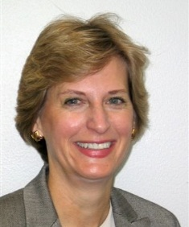
Featured Presenters
Jayne Sowers
Senior Technical Assistance Consultant
Great Lakes East Comprehensive Center
American Institutes for Research

Slide 9
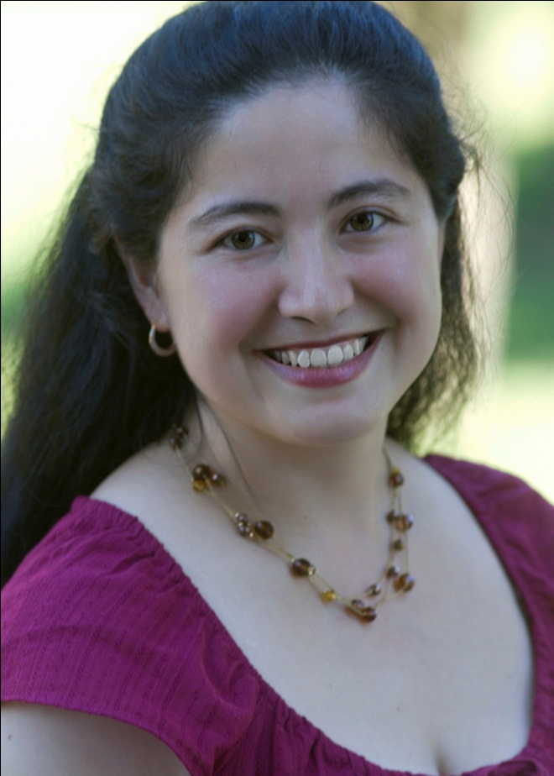
Featured Presenters
Reyna Hernandez
Assistant Superintendent for the Center for Language and Early Child Development
Illinois Board of Education

Slide 10
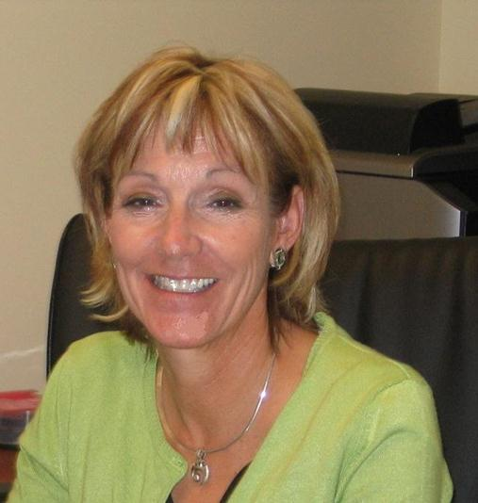
Featured Presenters
Janet Filbin
Director of Student Achievement
Hope Online Learning Academy Co-op

Slide 11
Q & A and Discussion

Slide 12
Q & A and Discussion
Please note that your phone line is muted upon entry and will remain muted (see red x in front of your name)
To get speakers’ attention, please use the “Raise Hand” button in the Participants Panel. We will un-mute then.
You can also post your questions or comments on the Q & A Panel.
Notes:
12

Slide 13
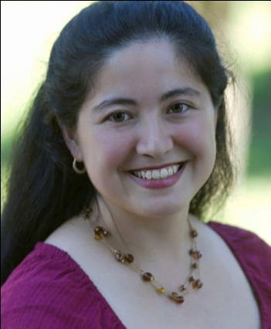
Panelists
Tom Kerins
Moderator
Jayne Sowers
Great Lakes East
Reyna Hernandez
Illinois SBE
Janet Filbin
Hope Online Learning
Notes:
13

Slide 14
For More Information www.centerii.org/leaders
Link to this webinar’s recording, slides and resources mentioned during the presentations
Feedback
Follow-up questions? Send to Nina de las Alas, ninaa@ccsso.org

Slide 15

Thank you to our featured presenters and thank you all for participating in today’s webinar. See you at our next webinar on September 18 at 3 PM ET!
Notes:
15

